Slide 1


Shangri-La Nanning
April 23-24, 2026
Tin Forum 2026
（Discount Code：AMG230426）
Online Room Booking Guide

Slide 2


The online booking portal will close on April 19, 2026.
Please book early to secure your room.
Grand Deluxe King Room：RMB700nett with one daily breakfasts
Grand Deluxe Twin Room：RMB800nett with two daily breakfasts
Horizon Premier Room：RMB1298nett with one daily breakfasts
Horizon Premier Room： RMB1398nett with two daily breakfasts

Slide 3
1.Open one of the following links to access the booking interface:
Chinese version:
http://www.shangri-la.com/reservations/booking/en/index.aspx?hid=CNNNG001&group_code=AMG230426&check_in=20260423&check_out=20260425
English version:
https://www.shangri-la.com/nanning/shangrila/?timeZone=+8&specialCode=AMG230426&specialCodeType=Group&checkInDate=2026-04-23&checkOutDate=2026-04-25&rooms=[{%22adultNum%22:1,%22childNum%22:0}]
Friendly Tip: If the reservation interface does not display the corresponding language content, you can click on the top right corner of the webpage to switch languages (Simplified Chinese, English, Japanese)

Slide 4
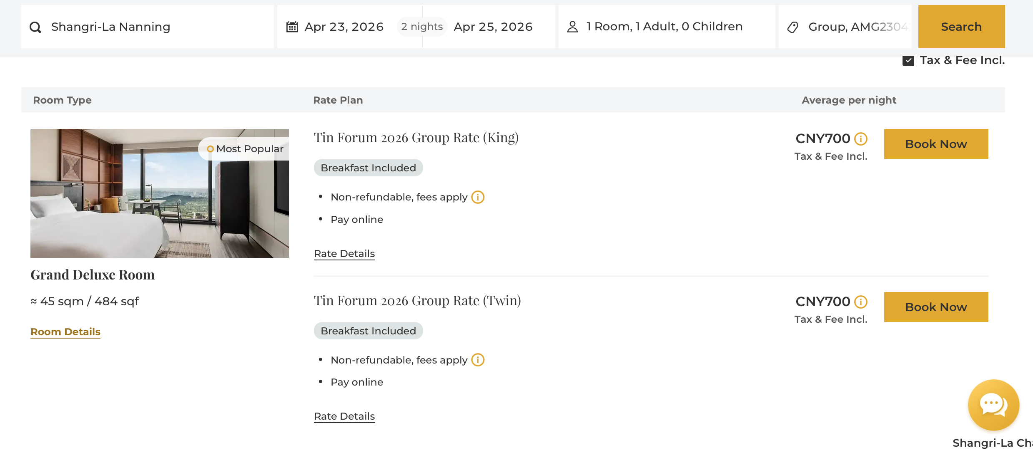
2.Select Room Type
Choose your preferred check-in and check-out dates.
Click the "Book Now".
Select the desired room type (King or Twin)

Slide 5
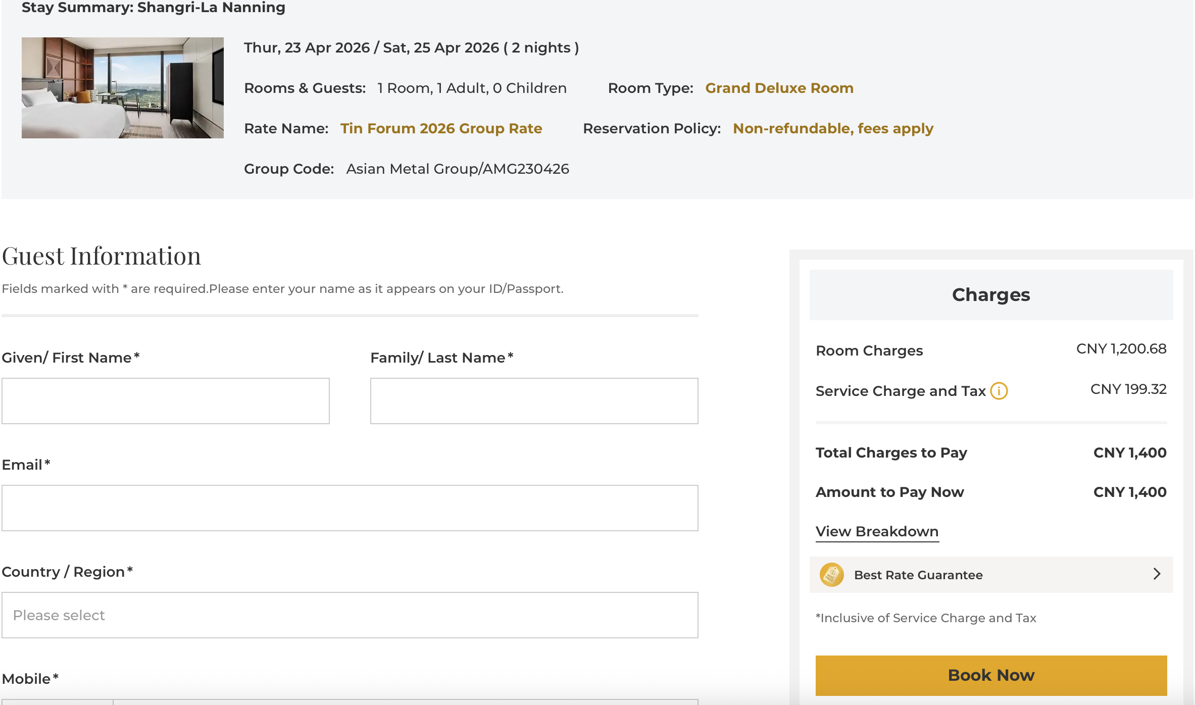
3.Enter Guest Details & Payment
Fill in the required guest information.
The total price for your stay will be displayed here.
Click "Book Now"
On the next page, choose your preferred payment method.
Click "Complete Booking" to finalize your reservation.

Slide 6
4.Booking Confirmation
Upon successful booking, a confirmation email will be sent to the address you provided.
Please double-check all details on the final screen:Hotel Name、Check-in / Check-out Dates、Room Type、Total Price、Confirmation Number.
Keep your confirmation number safe. You will need it for check-in.
If you need to check in early or check out late, and there is no matching room availability in the booking link, you can contact the hotel at any time to handle the booking.
If you have any questions, please Call 0771-256 8888 to the Reservation Department.
Please call and inform that you are a guest from Asia Metal (Tin Forum 2026) team.

Slide 7
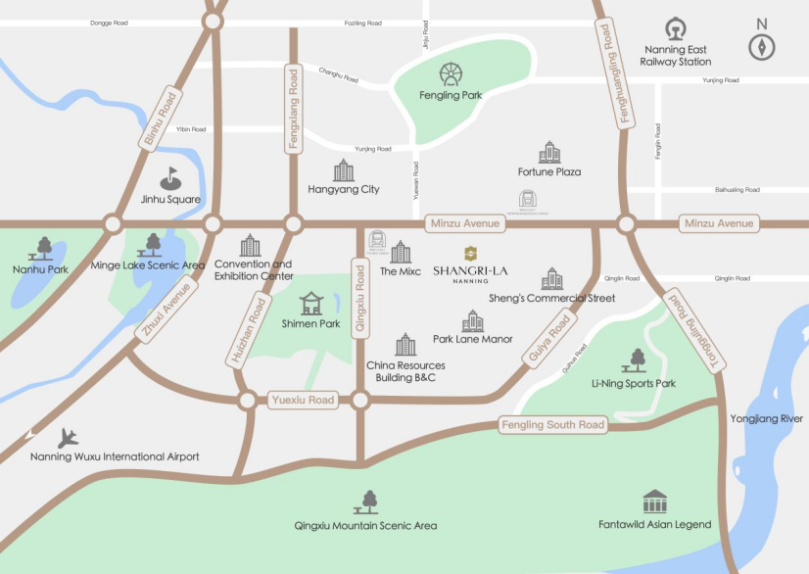
Contact Us
Address: No. 136-1 Minzu Dadao, Qingxiu District, Nanning, Guangxi, China
Phone: (86 771) 256 8888
Fax: (86 771) 259 8888

